Slide 2
Getting PrEP to where it is needed most: Opinions in Africa

Slide 3
Background
Survey created to understand how MSM use/access PrEP currently in Africa
10 anonymous questions with open response
Audience: MSM organizations in Africa
110 participants; 54 completed surveys

Slide 4
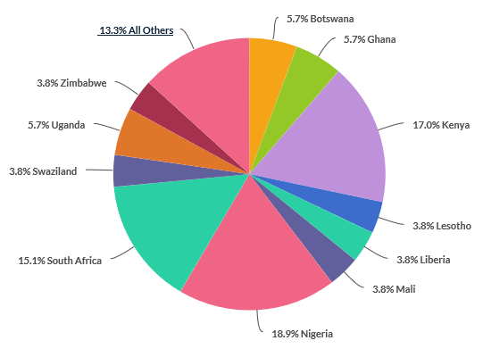
Demographics
Nigeria – 10 CBOs
Kenya – 9 CBOs
South Africa – 8 CBOs
Responses from Southern, West, East, and Northern Africa (Morocco)
Notes:
38% of participants were from Southern Africa : Botswana, Lesotho, South Africa, Swaziland, Zimbabwe, Malawi, Zambia, Mozambique (20 CBOs)
36% from West Africa: Ghana, Liberia, Mali, Nigeria, Burkina Faso, Gambia (19 CBOs)
25% from Eastern Africa: Kenya, Tanzania, Uganda (13)
1% from Northern Africa: Morocco (1)

Slide 5
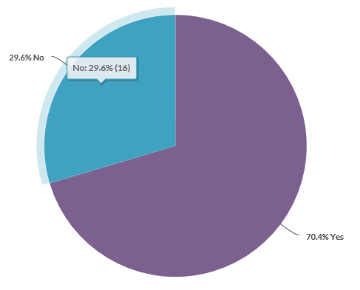
Q2: Is PrEP available in your country?
70.4% Yes*
*Those who marked this as available mostly noted that PrEP was only available under studies

Slide 6
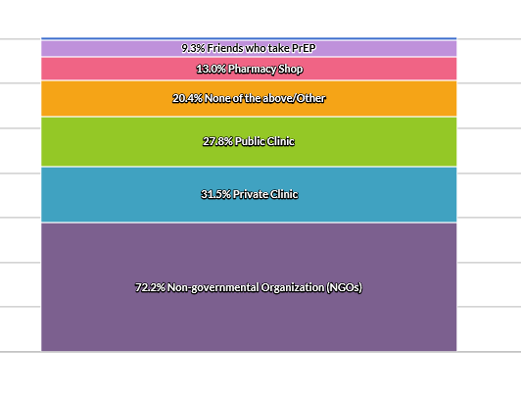
Q3: Where do MSM clients served by you/your CBO obtain their PrEP?
Notes:
Limitation: The majority of respondents who answered “No” to PrEP being available in-country still chose CBO as an option. For future surveys, there should also be an N/A answer choice. However, it can be assumed that CBOs would be willing to offer PrEP to MSM.

Slide 7
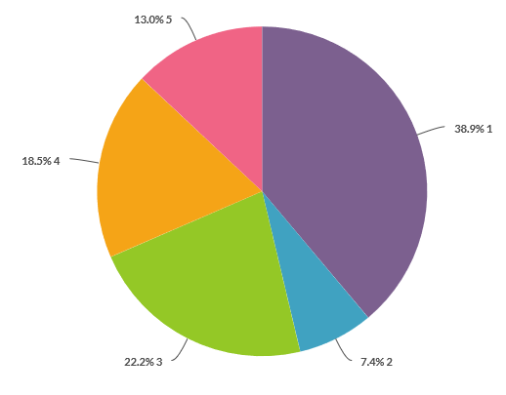
Q4: How easy is it for MSM clients served by you/your CBO to access PrEP in-country?
1 = Very difficult/not available
5 = Very easy
Notes:
Southern Africa
Not available – small (1)
Limited availability (only in certain areas/not in rural/or not at public) – (5)
Stigma and discrimination (2)
Cost (Botswana) not covered by insurance (1)
West Africa
Not available (5)
Stigma/discrimination/criminalization (2)
Limited availability (2)
East Africa
Readily available (3)
Stigma and discrimination by health workers
Limited availability (1)

Slide 8
Why is it easy/difficult for MSM clients to access PrEP in-country?
accessible
stigma
limited
discrimination
cost
Notes:
Southern Africa
Not available – small (1)
Limited availability (only in certain areas/not in rural/or not at public) – (5)
Stigma and discrimination (2)
Cost (Botswana) not covered by insurance (1)
West Africa
Not available (5)
Stigma/discrimination/criminalization (2)
Limited availability (2)
East Africa
Readily available (3)
Stigma and discrimination by health workers
Limited availability (1)

Slide 9
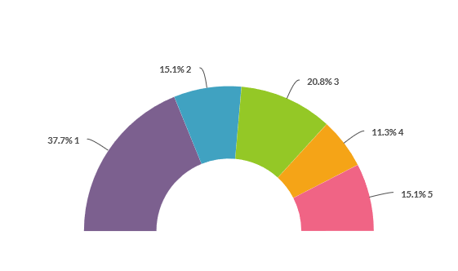
Q5: How supportive is your government in engaging MSM organizations in PrEP policy and planning?
1 = Unsupportive/in opposition
5 = Very supportive
Notes:
Common Responses:
The government is not doing enough to ensure access to PrEP; The government has established a policy but has not acted on it
There are lot of engagements at the government level; ongoing discussions
MSM often faced a lot of stigma and often subject to criminalization. Thus, the government do not have adequate intervention programs that are specific to MSM; some people still consider being MSM a taboo - criminalization

Slide 10
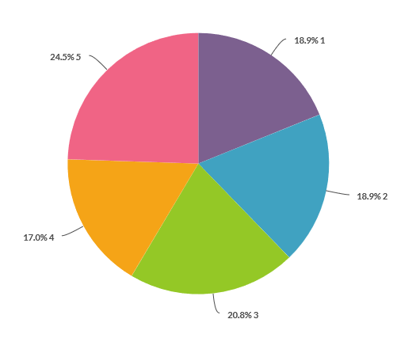
Q7: How engaged has the MSM advocacy community in your country been in advancing PrEP access in your country for MSM?
Notes:
1 – 38.9% (very difficult)
2 – 7.4%
3 – 22.2%
4 – 18.5%
5 – 13.0% (very easy)

Slide 11
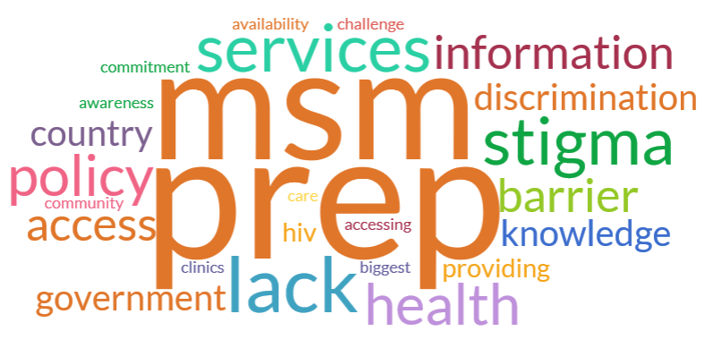
Q8: What is the single biggest barrier to MSM accessing PrEP in your country?

Slide 12
Recommendations
Provide additional funding for structural interventions; make PrEP free
Make PrEP available countrywide (expand reach); involve more CBOs for sustainability
Market PrEP for all populations, not just MSM to help decrease stigma
Conduct community research and evaluate impact; run pilot studies to help govt. buy-in
Conduct sensitization trainings for HCWs and government stakeholders
Notes:
Not widely available in public health facilities or in certain cities
Laws and policy (anti-gay laws/government criminalization)
Stigma and discrimination
Cost to beneficiary
Lack of information and awareness and understanding where people can access PrEP

Slide 13
Acknowledgement
GAY/MSM CSOs across Africa

